Slide 1
Watson Dietary Tradeoff System
Akshay Kumar
Saketh Patibandla
Nirmala Seshadri
Thushara Elizabeth Tom
Rong Zeng

Slide 2
Table of Contents
Introduction
Getting the data
Pareto Optimality
Watson Dietary Tradeoff System
Scope and Improvement
Conclusion

Slide 3
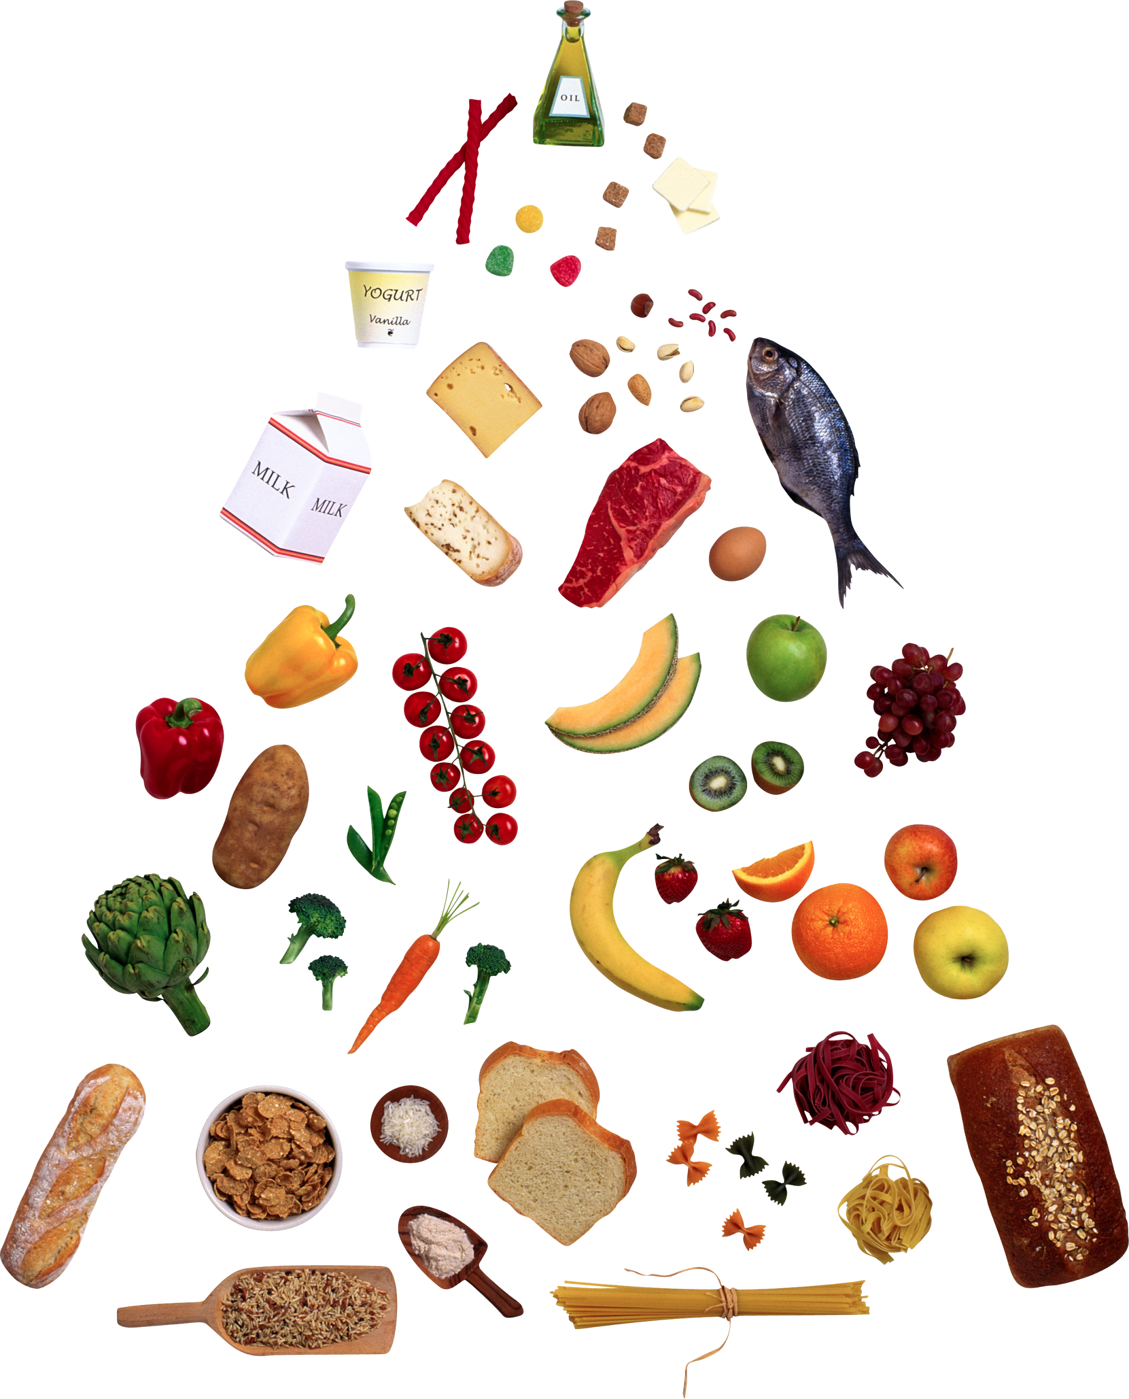
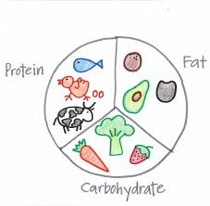

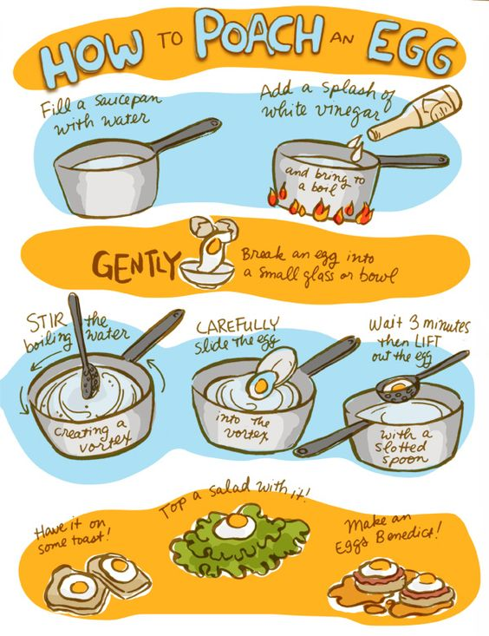
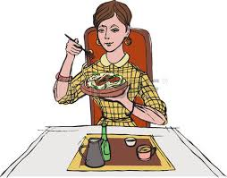
Introduction
The Watson Dietary Tradeoff system is a tool targeted at health conscious people, who like to plan their meals in advance.
It enables the user to obtain a shortlist of recipes relevant to their input of nutrient needs.
An optimal mix of recipes fulfilling the user’s planned diet will be generated by this tool which stimulates the user’s decision making process to select the one recipe for a meal,from an original database of over 300 recipes.

Slide 4
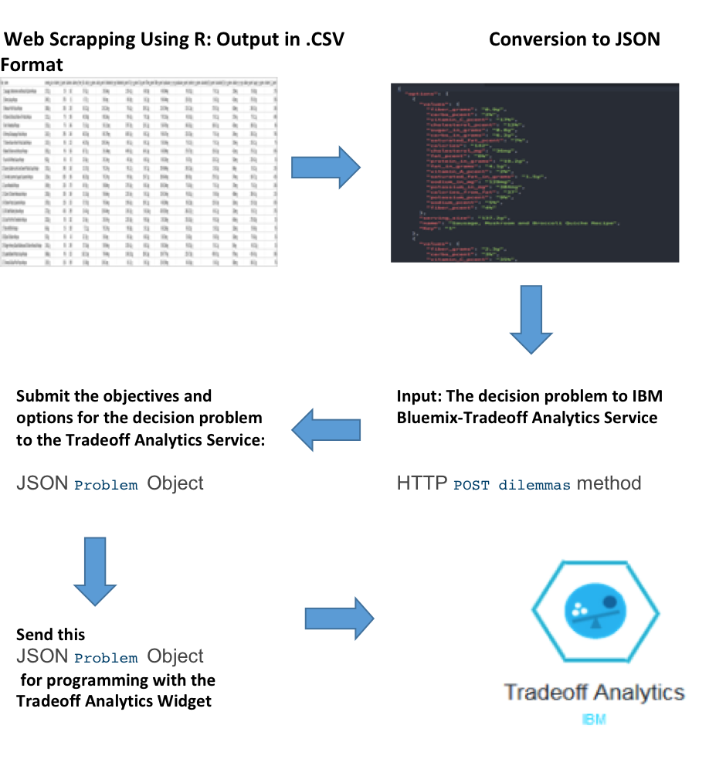
Introduction-The process

Slide 5
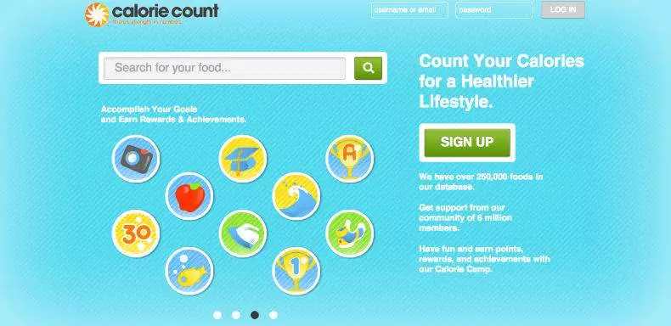
Getting the data
Website : https://www.caloriecount.com/
Notes:
Data Source : Calorie Count
Why Calorie Count ?
Contained vast amounts of data on recipes.
Each recipe had a fact table associated with it, containing details of the nutrients based on a specific serving size.
Easy to scrape.

Slide 6
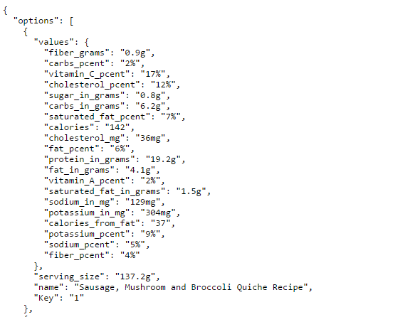
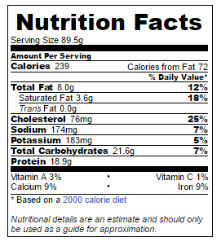

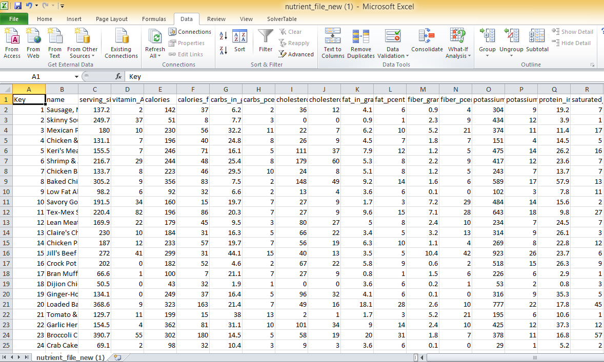
Getting the data
RSelenium Package
Data post scraping (.csv format)
Data on the website
Final data to Input to Watson (.json format)
Notes:
#NOTE - Animation added - Hence the overlap
RSelenium Package - linked to the Selenium WebDriver
Automates the process of going through the website and scrapping the required data
Nutrition fact table is attached to each recipe on the calorie count website, data is scraped and stored in a .csv file
Automatically scraped over 200 recipes
.csv -> .json format to be loaded into IBM Watson system, using a Python script.

Slide 7
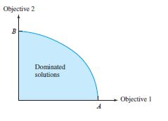
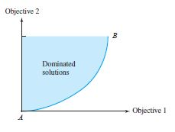
Pareto Optimality(80/20 Rule)
A Pareto efficient situation occurs when there is no outcome that makes at least one player better off without making at least one player worse off.
For a multi-objective problem, there exist N feasible solutions that form a Pareto Optimality.
A trade off curve can be drawn for a multiobjective problem.
I: Maximize Objective 1 and Objective 2
II: Maximize Objective 1 and minimize Objective 2
I
II

Slide 8
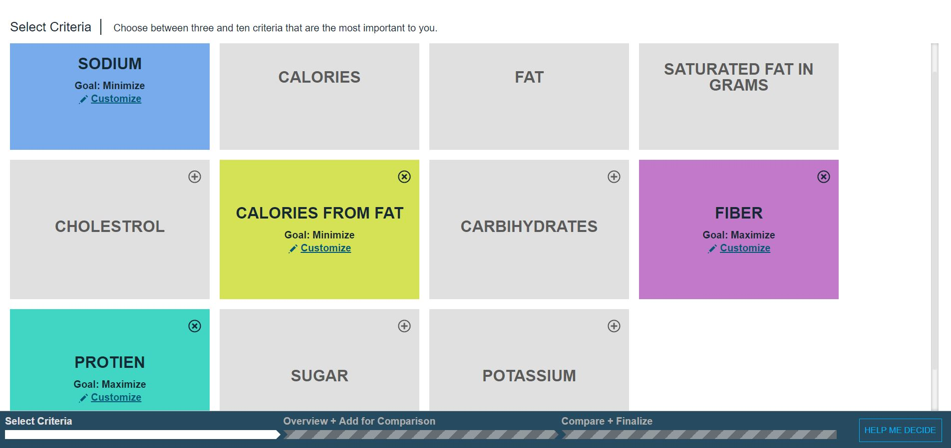
Dietary Tradeoff System - Nutrient selection

Slide 9
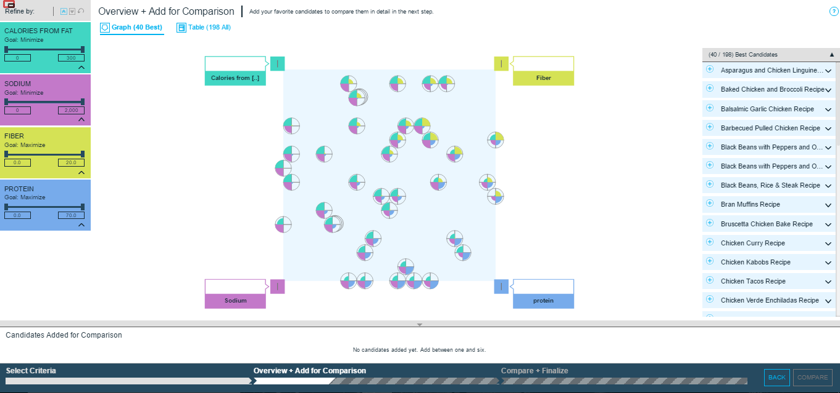
Dietary Tradeoff system - Recipe Selection

Slide 10
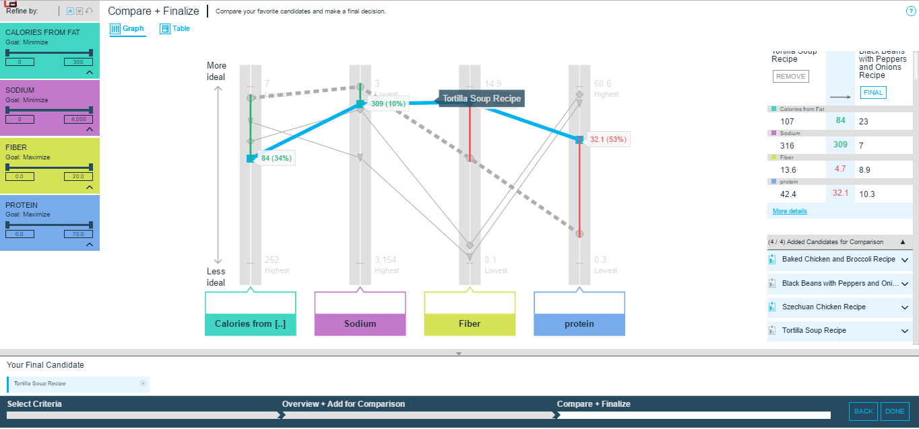
Dietary Tradeoff System - Recipe Tradeoff & Analysis

Slide 11
Scope and Improvement
Further work will be carried out to incorporate a price criteria in the decision problem. We plan to add a database of the costs of making the recipes based on its ingredients. If users are price sensitive，they can save more money without reducing nutrition.
Another expansion would be to add a customized fitness program based on inputs from the user regarding expectation from the workout like calories to burn, different flavours to choose and time willing to spend.

Slide 12
Conclusion
The model is primarily targeted for diet conscious people who like to keep track of their nutrient intake and plan their meals accordingly.
Our team has put in a lot of effort to successfully build the Dietary Tradeoff System using IBM Watson Analytics platform.In the future we will improve the system and add more functions to meet the user’s needs.
Due to the lack of a competing product in this field, our Dietary Tradeoff System has a great potential in the future.

Slide 13

Watson Signing off! Goodbye humans!
Notes:
Feel free to remove this :P.

